Slide 1
Leading Out of Crisis:
Recovering “Your”
Business “Together”

Slide 2
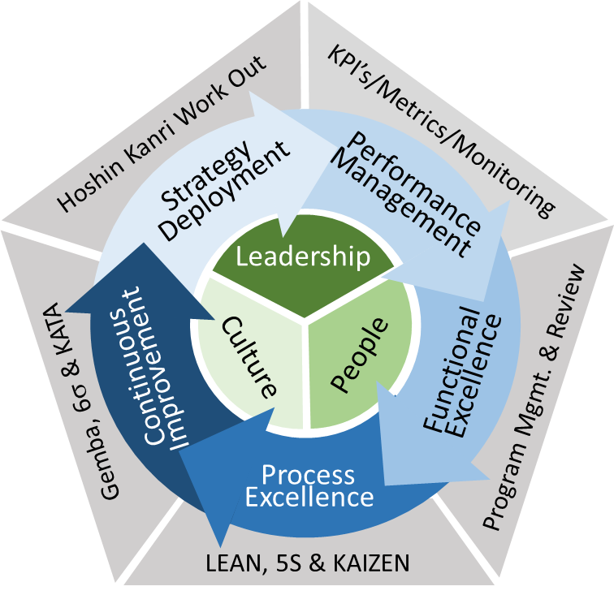
Introduction
Ascent OpEx, LLC
Helping small to mid-sized companies translate vision, strategy & initiative into sustained results.
20+ years supporting capital region business leaders driving continuous improvement with Operational Excellence methods & tools
Partnering from the board room to the line level to develop right sized programs & solutions that drive performance, quality, reduced cost and growth.
Supporting the development of Leaders, People and a Culture of Improvement

Slide 3
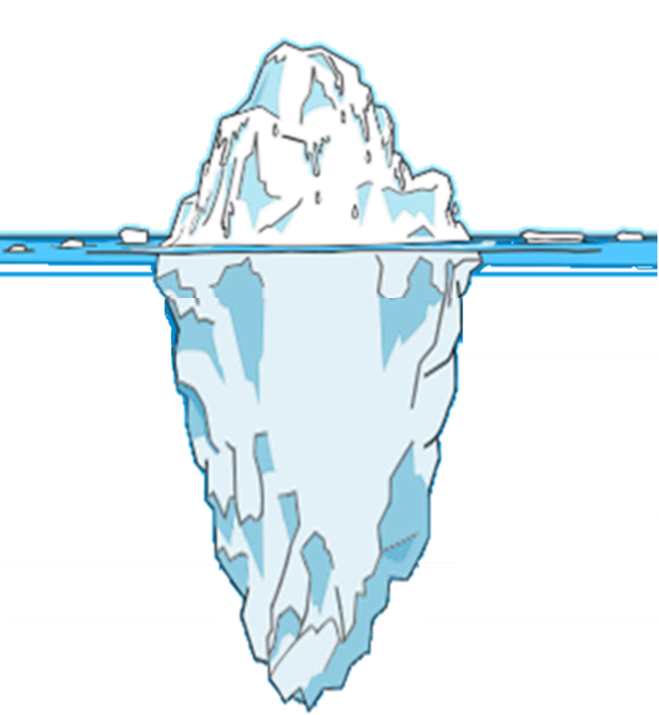
Shifting Focus in Crisis
Fear
Home School
Closures
Emotional
Stressed
Directive
Reactive
Quick
Distancing
Leading
in
Crisis
Shelter in Place
Quarantine
N95
3/20 – 5/19
PPP
Lay-offs
“Opening” Guidelines
Leading
out of
Crisis
5/20 – (?)
“New” Normal for You
Unforeseen
Threats
The majority of challenges remain to be exposed.
Notes:
The ice-berg is great imagery that is used frequently in continuous improvement discussions. The typical talking point is that you only see the 20% of the cost of an issue, where as 80% remains hidden. And no matter how you try to tolerate the 20%, the 80% still lurks below, killing your business.
The metaphor works great for this and most other crisis.
For the past two months many of you have been faced with Lay-offs , others with dealing with your PPP loan, possibly business closures, some becoming teachers at home, everyone has been hit by social distancing and sheltering in place. IT HAS BEEN A DRAIN ON YOU AND YOUR TEAM
Going forward, we will be dealing with the opening guidelines, the new normal for your business will continue to evolve, there will be uncertainty among your employees and your customers.
We are fortunate to have the Saratoga County Reopening Advisory Group to provide detailed guidelines about timing and requirements.
The reality is that the majority of the challenges remain to be exposed today. They will continue to lurk out there and eventually rise up as you chip away at the iceberg. The goal is to see them now.
In the beginning we were leading in crisis. We had to fight the good fight. In fight mode we tend to be emotional, stressed, reactive and probably stressed. Bottom we had to do what was necessary to see tomorrow. But, that comes with consequences. Often driving fear & anxiety in you and your team and sometimes less than perfect decisions
The question becomes how do we lead out of the crisis.

Slide 4
Leading Out of Crisis
Six steps to effective execution
Step Back & Build Understanding
Engage the Team
Widen the View & Map the Business
Identify “ALL” Threats & Prioritize
Plan, Delegate & Execute
Communicate Transparently & Listen
Don’t lead the charge without your team aligned and confident!
Notes:
I love this photo. It has been used several times during this crisis. It really reflects what we are facing. We cannot see the end (yet), we struggle to see more than what is directly in front of us and don’t know what could be coming at us from any direction. But we know that if we fall, it will be a big drop.
In the photo you can see an image just to go out of sight, a leader possibly. Some would say that is the sign of a true leader, charging off into the abys to show the team it is safe. But, once the leader disappears, the team is left alone, uncertain and more fearful.
As we lead out of this crisis, we must develop a different approach that ensure the team crosses that bridge with us, confidently and aligned. Here is a process that will help pull them along.
Step Back & Build Understanding- Stop fighting for a moment. Collect your thoughts. Is that bridge the right bridge?
Engage the team- If we play our cards right, we may increase morale, find new leaders and build a stronger team.
Widen the view and map the business – We have been laser focused on our P&L for the past 2 months… But there is much more to the business than that.
Identify ALL threats and prioritize - Spend the time to identify the bottom 80% today. There is nothing worse than fearing what is around the corner. Focus on the top priority issues and monitor the trivial.
Plan, Delegate & Execute - Develop a structure to address the issues using the extended team, down to the line level. You will find that they are capable.
Communicate Transparently & Listen - Don’t sugar coat the message. Give them the good, the bad and the ugly. Then listen. Tell them what the want to know.

Slide 5
Step Back & Build Understanding
What is your new normal?
Spend time gathering intel not executing.
Replace emotion/gut-feel with data/fact.
Start with “group theory” & course correct as clarity becomes available.
Leverage peers, industry communities, chambers, MEP’s & state guidance.
Document your “new normal”, both short term and the future
Define your business “new normal” landscape & prepare to adjust.
Notes:
Step away from the day to day battle and revisit your business model and figure out what your new normal will look like. It will certainly be different for many months but for certain industries it will be transformed for ever. You and your team need to know the landscape before you can build a plan to recovery.
It is critical we use data and facts and not gut feel and emotion to drive our thinking. We need to be efficient and it will help align the team.
Start with “group think” within your direct team, leverage peers, industry associations, your chamber, what ever is available to help identify what the new normal will look like for your business. Then be flexible enough to course correct as things evolve.
At some level, there has been a benefit to opening up later than other states, leverage their mistakes. VT has been progressing for 3-4 weeks already and have been meeting weekly to discuss lessons learned and best practices. In the words of Jack Welch, steal shamelessly. Don’t make the same mistakes others have made if you don’t have to.
Write your new normal assumptions down and continually adjust the list as you proceed. Some of the changes are immediate and some will evolve over time.

Slide 6
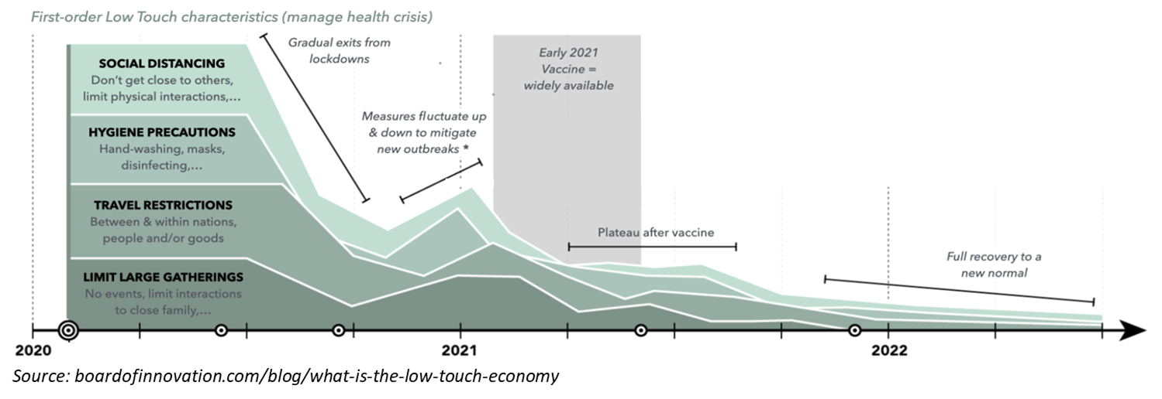
Leverage Available Resources
https://accd.vermont.gov/covid-19/business/restart
https://www.governor.nh.gov/news-media/press-2020/20200501-stay-at-home.htm
https://newyorkmep.org/wp-content/uploads/2020/05/NYMEP_COVID19_playbook4305.pdf
https://www.saratogacountyny.gov/county-reopening/
Notes:
Here are just a couple of resources that I have been using to help build my understanding of the new normal.
The bottom graph is actually a pretty good way to break down the projected restrictions over time. The sources are listed on the presentation. I will post the presentation on my website by the end of the day.

Slide 7
(1) https://pmessentials.us/stakeholder-management-key-project-success/
(2) https://www.kornferry.com/content/dam/kornferry/special-project-images/coronavirus/docs/KF_Leadership_Playbook_Global_FINAL.pdf
Engage the Team
They are your greatest resource.
Natural response is “fight or flight”. Engage the team in the recovery fight.
Initiatives are 40% more successful with engaged stakeholders ⁽¹⁾
“69% of the world’s most admired companies (reported) employee engagement was higher after the global financial crisis in 2008…” ⁽²⁾
Experts surround you from the board room to the line level. Extract solutions.
Notes:
Pillar number 2 emphasize the importance of the team. But why? From an HR purist standpoint, employee engagement drives performance, customer satisfaction, retention and culture. All of these are true, but right now we are being a little more self serving.
Great leaders know that including their teams early is the process drives:
Increased confidence and alignment; Engaging the team in focused initiative and activity will help reduce fear and anxiety and the threat of flight!
Projects are significantly more likely to succeed with engaged teams regardless of the barriers that arise.
Involvement will lead to increased employee engagement after the recovery. There was a great KornFerry study following the financial crisis of 2008 that interviewed the worlds most admired companies and found 70% of these companies reported increased employee engagement upon recovery.
Great leaders know how to leverage the knowledge and talent that is in each of us. There is a great book called the Idea Driven Organization that is based on the principle that 80% of all successful innovation and improvement ideas come from the front line worker.

Slide 8
Widen the View & Map the Business
Engineering
Customer Service
Manufacturing
Internet
Operations
In-Store
Sales/Revenue
Fixed Expenses
Supply Chain
2020
Objectives
Distribution
Staff/Admin
Infrastructure
Marketing
Expansion
Your Business
2-3yr
Vision
Labor
Resources
Growth
External Services
Profitability
Customers
People
International
Domestic
Family
Health
Local
Stake
Holders
Engagement
Owners
Partners
Community
Your business is much more than your 2020 P&L statement
Notes:
It is important to take inventory of your entire business if you want to identify all of the threats you will face.
For the past two months many business leaders have been forced to focus almost solely on the business profit and loss statement. Making decisions about staffing, PPP loans, possible closures, etc.
Your business is much more than your P&L. Within your 2020 objectives you also have your supply chain, distribution, infrastructure
Maybe your 2-3 year vision and strategy; Resources, Stake Holders (internal & external), Customers and your people.
This type of a visualization tool is a mind map and is a great way to brainstorm and present the complexities of an issue.

Slide 9
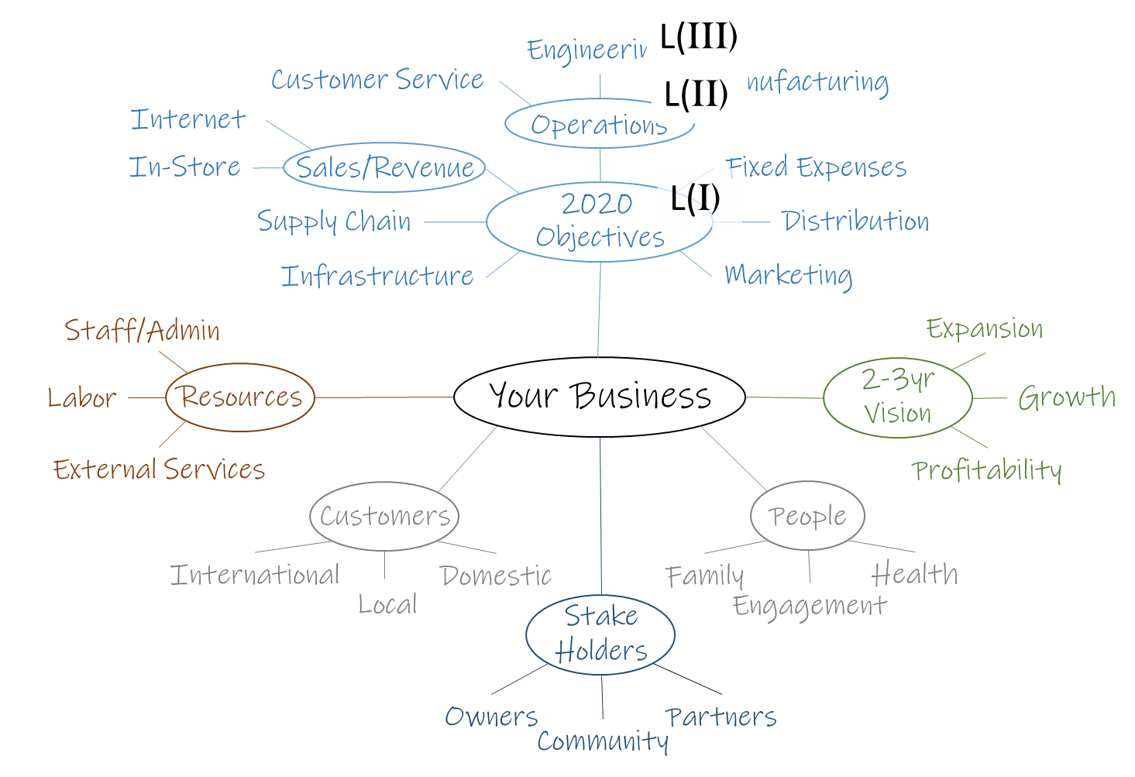
Widen the View & Map the Business
Mind Mapping 101
Engage the team… Consider new players
Don’t rush the activity… Let people think
Discussion = Alignment… Encourage it!
Rank level (II) & (III) Business Elements (BE) based on business impact.
Rankings: High/Med/Low… Force stratification 20%/60%/20%
Notes:
Mind mapping is a great facilitation tool that engages a larger portion of the team and in this case the team provides perspective. Parts of the business that you as a leader may think are trivial, may be significant to someone else. When you are done you want to have a visual that represents all of the business elements in a single picture.
Consider bringing new levels of the organization into the discussion to gain perspective. Also, consider having someone else lead the activity; Share your expectation of the new normal and share the basis behind it… Take every opportunity you can to gain deeper alignment, lifting the fog and bringing the end of the bridge into view.
Facilitation takes time… The goal is to get input from everyone involved and some people take longer than others. Allow for discussion, debate and argument all drive alignment and shared vision… Like a good parent, a good facilitator knows when to allow things to escalate and when to diffuse a situation.
Finally, just because an element of the business is on the map does not make it any more or less important as any one of the others. The end goal of the whole (6) process is to address the critical issues first. Rank the business elements High, Medium and Low… Keeping in mind, not everything can be high!

Slide 10
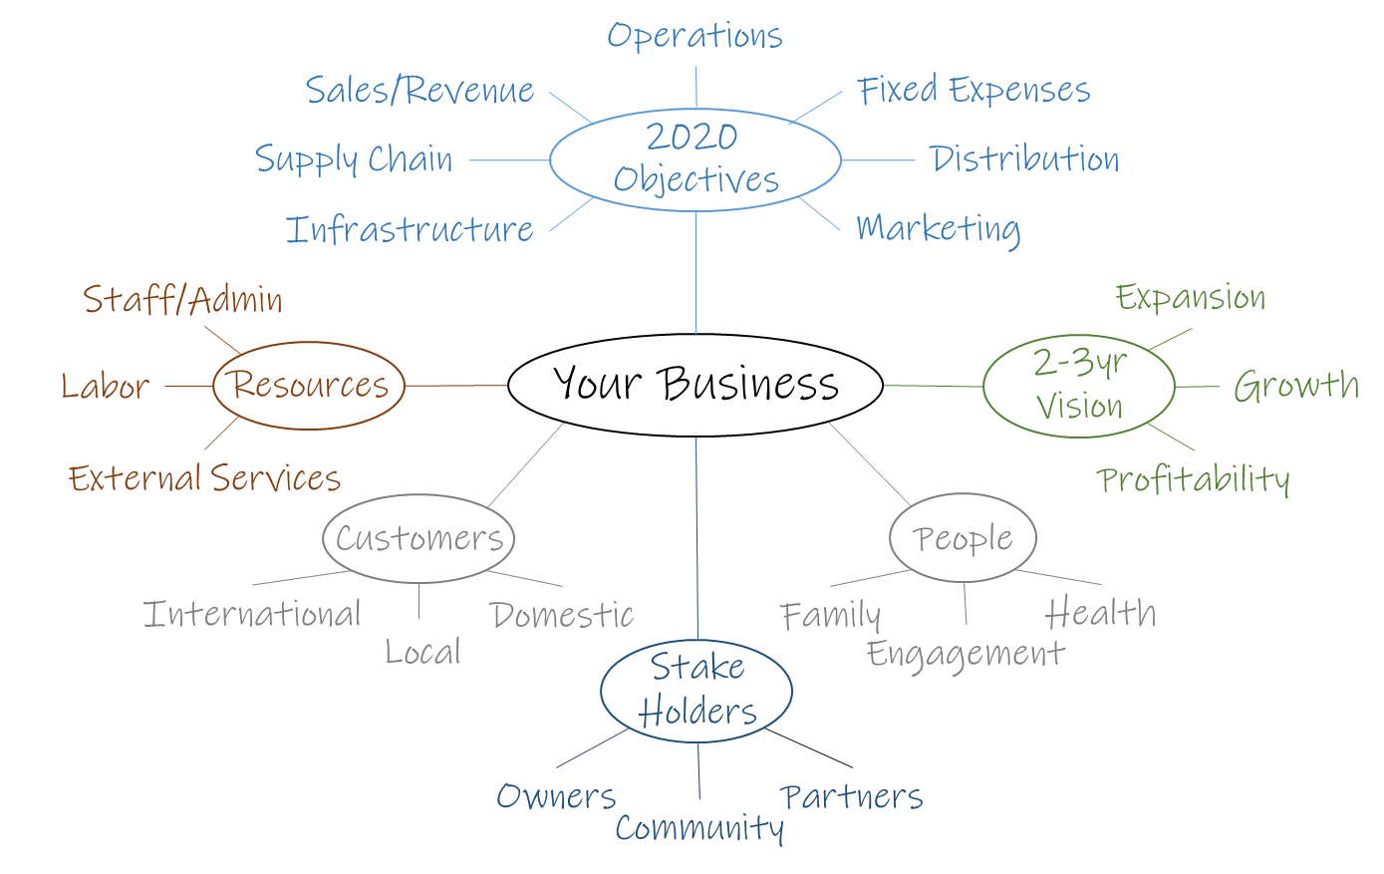
Identify “ALL” Threats & Prioritize
SOCIAL DISTANCING
Regional Delayed “Opening”
CLOSED GLOBAL SC
Driver Services/Amenities
In House Screening
SHRINKING CAPITAL
Daily Disinfection
FEAR
Home
Schooling
Market Transformation
BANKRUPCIES
COVID-19 II
Travel Bans
Isolation
Contraction
Convention Bans
STRESS
Uncertainty
Relentless
In-Need
DIVIDED
Your business is under attack from every direction
Notes:
With the business mapped, you can start to flesh out all of the threats lurking in the back ground. These are the 80% of the iceberg that are below the surface, the unforeseen threats that eventually will arise. Maybe next month, maybe in 3 months, maybe in a year, but they are risks to your business and they are coming in all different sizes and from all directions.
Simply identifying them with the team will remove a little more of the fog on the bridge and drive confidence within the organization.

Slide 11
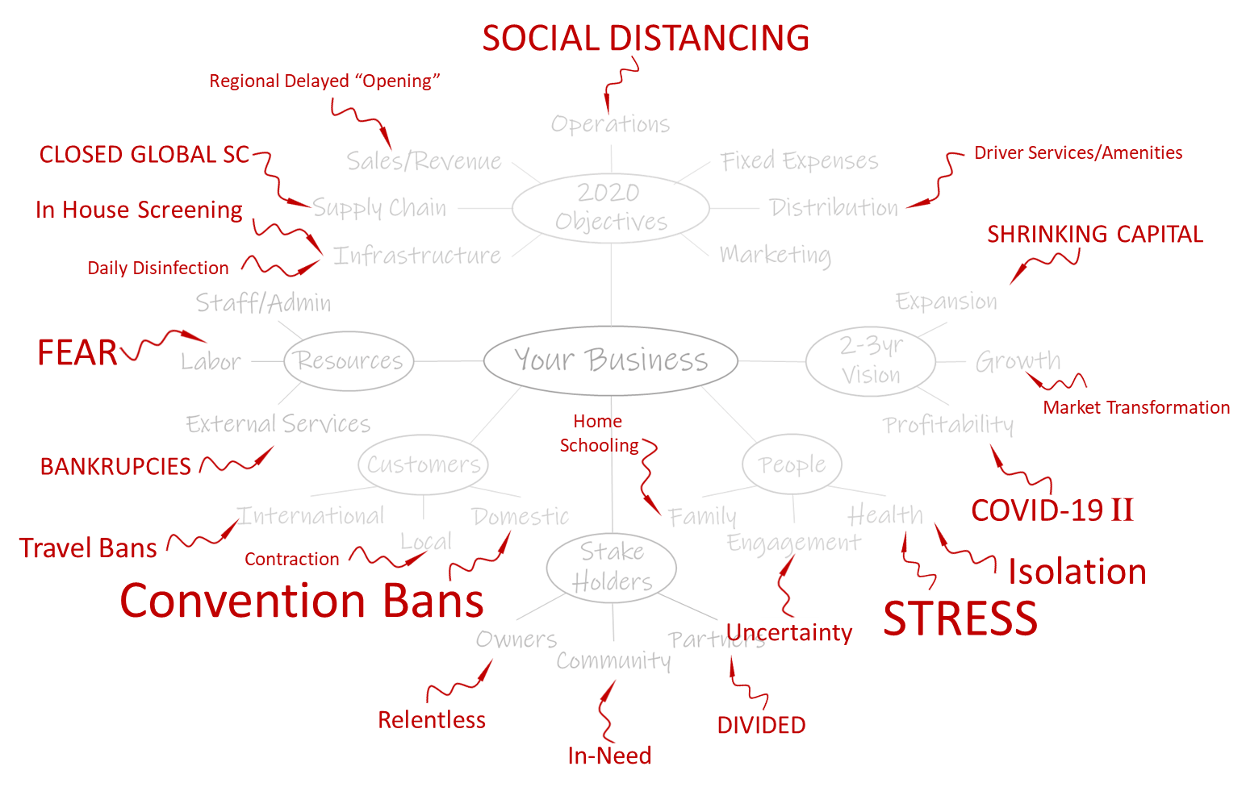
Identify “ALL” Threats & Prioritize
Brain Storming 101
Engage deeper in the organization.
Share “new normal” understanding & business map.
Think out of the box: People, Processes, Equipment, Measures, Environment & Materials
Evaluate each business map element.
Compile “opportunities” if they come up.
Notes:
As we progress with the activity there is more opportunity to engage deeper in the organization. This is actually critical as this will not only identify the obvious risks, it will give you vision into the thoughts and concerns of your staff, which could be the most valuable thing you could ask for. Capturing their concerns and talking about them will give them a voice and a sense of input and ownership.
Again, spread the message… Share the new normal & the business map.
Like mind mapping this takes time and you may have to draw input out of the new participants. If things are slow, ask people to consider the (6) threat sources as starting points for each element to help people think out of the box. If those do not make sense for your business, brain storm threat types that would work. This is just to grease the skids a little.

Slide 12
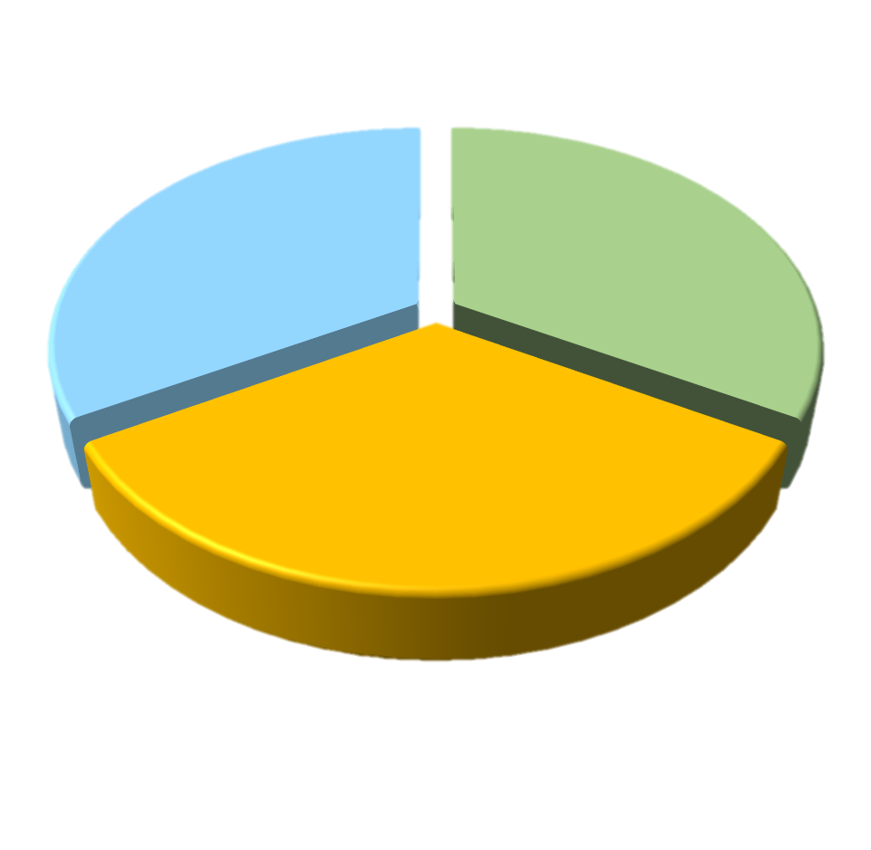
Identify “ALL” Threats & Prioritize
The “Threat Priority Number”
Threats are defined by (3) elements… “Likelihood”, “Impact” & “Influence”
Likelihood: Probability that this threat will impact the business during the recovery.
Impact: Size of the affect this threat would have on your recovery.
Influence: Ability to leverage existing business controls or historic practices to minimize the "Impact" of a threat.
Notes:
With any luck you will have way too many risks to reasonably address. That is honestly the best possible outcome!
But we need to be able to rank the threats so we can focus on the top issues!
There are (3) elements that characterize each threat. The likelihood that the threat will occur and impact the business. The impact that the threat would have on your business if it did occur. And the ability for your existing business controls and practices to influence or minimize the impact if and when it occurs.
Using the same team, each element should be ranked using a High, Medium and Low scoring strategy to allow for eventual prioritization. This can be done as a group assessment however, is best if you create definitions for H/M/L for each element as it replaces subjectivity and emotion with objectivity and data.

Slide 13
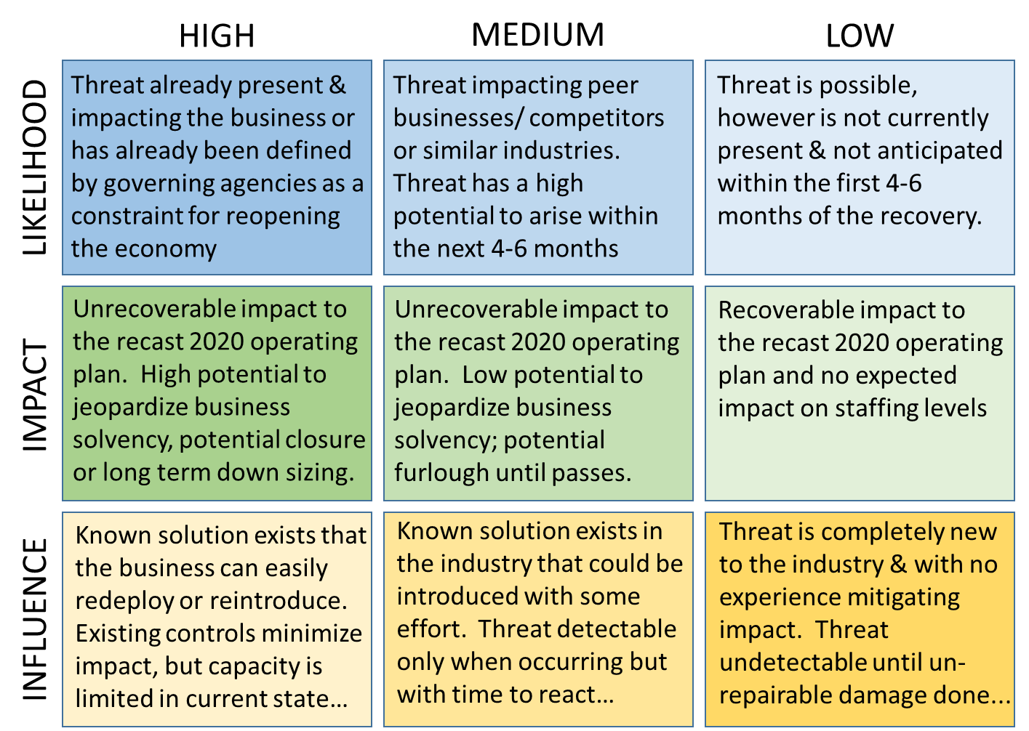
Identify “ALL” Threats & Prioritize
Definitions
HIGH
MEDIUM
LOW
Threat already present & impacting the business or has already been defined by governing agencies as a constraint for reopening the economy
Threat impacting peer businesses/ competitors or similar industries. Threat has a high potential to arise within the next 4-6 months
Threat is possible, however is not currently present & not anticipated within the first 4-6 months of the recovery.
LIKELIHOOD
Unrecoverable impact to the recast 2020 operating plan. High potential to jeopardize business solvency, potential closure or long term down sizing.
Unrecoverable impact to the recast 2020 operating plan. Low potential to jeopardize business solvency; potential furlough until passes.
Recoverable impact to the recast 2020 operating plan and no expected impact on staffing levels
IMPACT
Known solution exists that the business can easily redeploy or reintroduce. Existing controls minimize impact, but capacity is limited in current state…
Known solution exists in the industry that could be introduced with some effort. Threat detectable only when occurring but with time to react…
Threat is completely new to the industry & with no experience mitigating impact. Threat undetectable until un-repairable damage done...
Pre-established definitions converts subjectivity to objectivity
INFLUENCE
Notes:
Use of predefined High, Medium and Low criteria replaces the emotion and subjectivity with data and objectivity.
These definitions are broad and generally applicable, however may not be appropriate for your business or industry. Take the time to refine the definitions with your team to be more suitable.

Slide 14
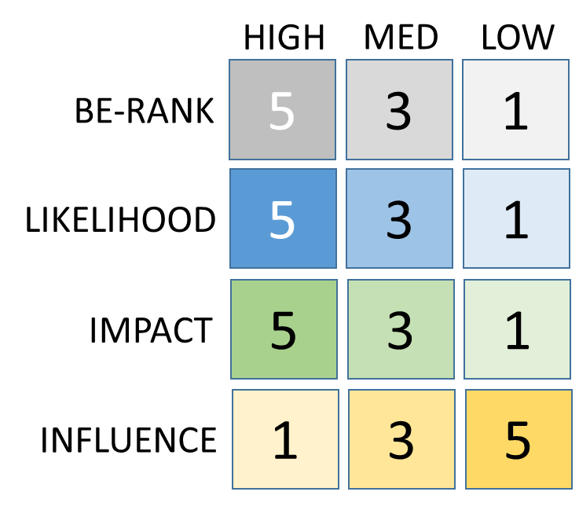
Identify “ALL” Threats & Prioritize
TPN Calculation
HIGH
MED
LOW
TPN = BE-RANK X LIKELIHOOD X IMPACT X INFLUENCE
5
3
1
BE-RANK
5
3
1
LIKELIHOOD
5
3
1
IMPACT
1
3
5
INFLUENCE
Do a sanity check & adjust… Gain alignment
Largest TPNs pose greatest business risk
Replace Emotion with Fact & Math to Set Priorities
Notes:
We now need to combine the information from the mind map ranking and the risk ranking to create a ranking value that sets everything on a level playing field and clearly identifies your top threats. Using the Threat Priority Number math sets our priority, not emotion or intuition.
Clearly a threat targeting a highly important business element, which has a high likelihood of occurring and have a high impact on the business and you have no ability now to influence is VERY IMPORTANT.
When you are done, do a sanity check of the results with the team and then going forward work top down to address the threats.
I have developed an xcel tool that I will share that can help manage the prioritization and planning process. I will include a link in the presentation for you to access it and to download it if you wish.

Slide 15
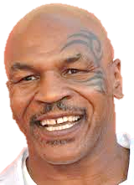
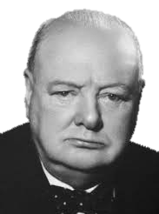
Plan, Delegate & Execute Threat Reduction Activities
Develop tasks/projects addressing top TPN’s. Don’t take on too much but plan for failures.
Understand the target (Likelihood, Impact or Influence). Poor focus risks project success.
Define tangible success and validate results
Review collateral impact.. Avoid new threats
Delegate downward & support the Team.
“Everyone has a plan, until they get punched in the face.” --
Mike Tyson
“Those who plan do better than those who do not plan… even though they rarely stick to their plan.” --
Winston Churchill
Expect set backs, learn & adjust quickly
Notes:
With the whole list of prioritized threats in front of you, begin developing projects or tasks to reduce the top threats.
A threat can be reduced by reducing the Likelihood, Impact or the ability of the business to Influence the threat if it occurs. In most cases it is not necessary to address all three. It is often beneficial to recalculate the TPN after you have completed the project to make sure that the result drops the threat out of the “Top”. Set tangible targets for a successful project (ie: how would you measure the success?) In many cases this may simply the completion/implementation, but make sure to set dates and validate the result.
Prior to implementing a proposed solution, make sure that it does not create new issues. Working remotely may address a number of threats and actually may look like an opportunity but the long term effects of isolation may be an issue.
Ideally, you can delegate the project leadership responsibility deep into the organization. However, based on the skills of your team that may not be practical. In this case, engage the team in the solutions
Finally, expect set backs and be prepared to adjust your plans quickly.

Slide 16
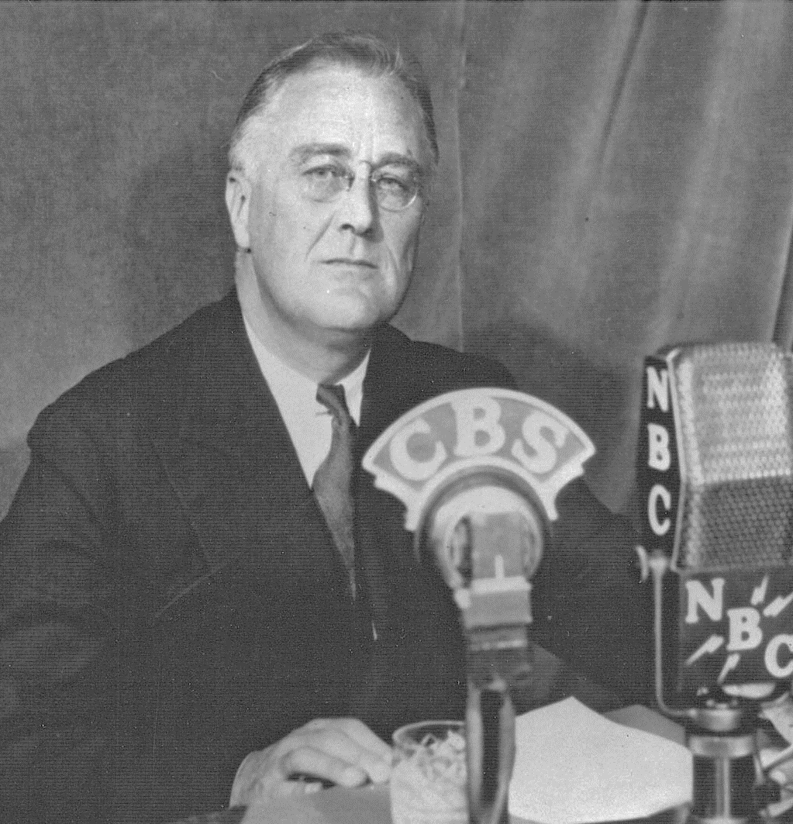
Communicate Transparently & Listen
In crisis people seek clarity & truth. Lacking input, alternate truths fill the gaps.
Don’t assume the team is alignment & committed. It must be developed.
Increase communication. Share the plan, successes, failures, progress & setbacks.
Include everyone! Board room to line level.
FDR “fire side chats” elevated societies post depression confidence in the government through open and frank dialogue about the challenges & successes the country was experiencing.
Seek feedback, adjust & share again. Tell them what they want & need to know.
Notes:
All businesses have the “rumor mill”. Bottom line, without information people start connecting dots and drawing their own conclusions that seldom are the truth. In crisis this is amplified
Increase communication because the level of uncertainty is high right now! It is better to over communicate than to have to address the alternate truths that fill the gap.
After you have communicated, seek feedback. This will tell you where you missed the mark or where more information is needed. Always be willing to adjust the message.

Slide 17
Leading Out of Crisis
Step Back & Build Understanding
Engage the Team
Widen the View & Map the Business
Identify “ALL” Threats & Prioritize
Plan, Delegate & Execute
Communicate Transparently & Listen
Recover “your” business “together”!

Slide 18
Ascent OpEx, LLC is a management consulting firm focused on helping businesses drive operational excellence within their organization. Working from the boardroom to the line level, we help develop strategies, programs and solutions tailored to address the needs, objective and limitations of your organization. With 30 years of experience delivering elevated performance, reduced cost, increased efficiency and cultures of improvement, we are your partner in the pursuit of excellence.
www.ascentopex.com

